Slide 1

Khulna University of Engineering & Technology
Course: CSE 4208
Course Title: Computer Graphic Laboratory
Cafeteria Graphics Design
Presented by
Israt Tasnim Esha
Roll: 1907090

Slide 2
Outline
Objectives
Introduction
Features
Visual Representation of the Project
Conclusion

Slide 3
Objectives
To explore modern OpenGL features like shaders, transformations, and lighting.
To create Complex 3D Objects like cube, sphere, polygons, hollow polygons, torus, and cone, and curve objects using Bezier curves.
To apply translation, rotation, and scaling to objects.
To implement ambient, diffuse, and specular lighting.
To apply textures to objects for realism.
To create motion for objects.

Slide 4
Introduction
Cafeteria Design: A detailed cafeteria is created, featuring various interior design elements such as tables, chairs, mirrors, sinks, sofas and lighting using polygons and cones. The cafeteria also includes a functional sliding door.
Theater Space: The theater features a comfortable layout with sofas, lights made of torus and a working ceiling fan. It also includes a functional sliding door, a functional curtain that can open and close, and a working TV capable of displaying dynamic content.
Flying Balloons: The sky is adorned with flying balloons created using spheres and Bezier curves.

Slide 5
Introduction Cont’d
Compact Kitchen: The kitchen is equipped with essential elements, including a sink, microwave oven, stove, and cabinets.
Operational Lift System: A fully functional lift system is implemented to navigate between the ground floor and the first floor.
Dynamic Day Modes: The project incorporates morning, noon, afternoon, evening, and night modes.

Slide 6
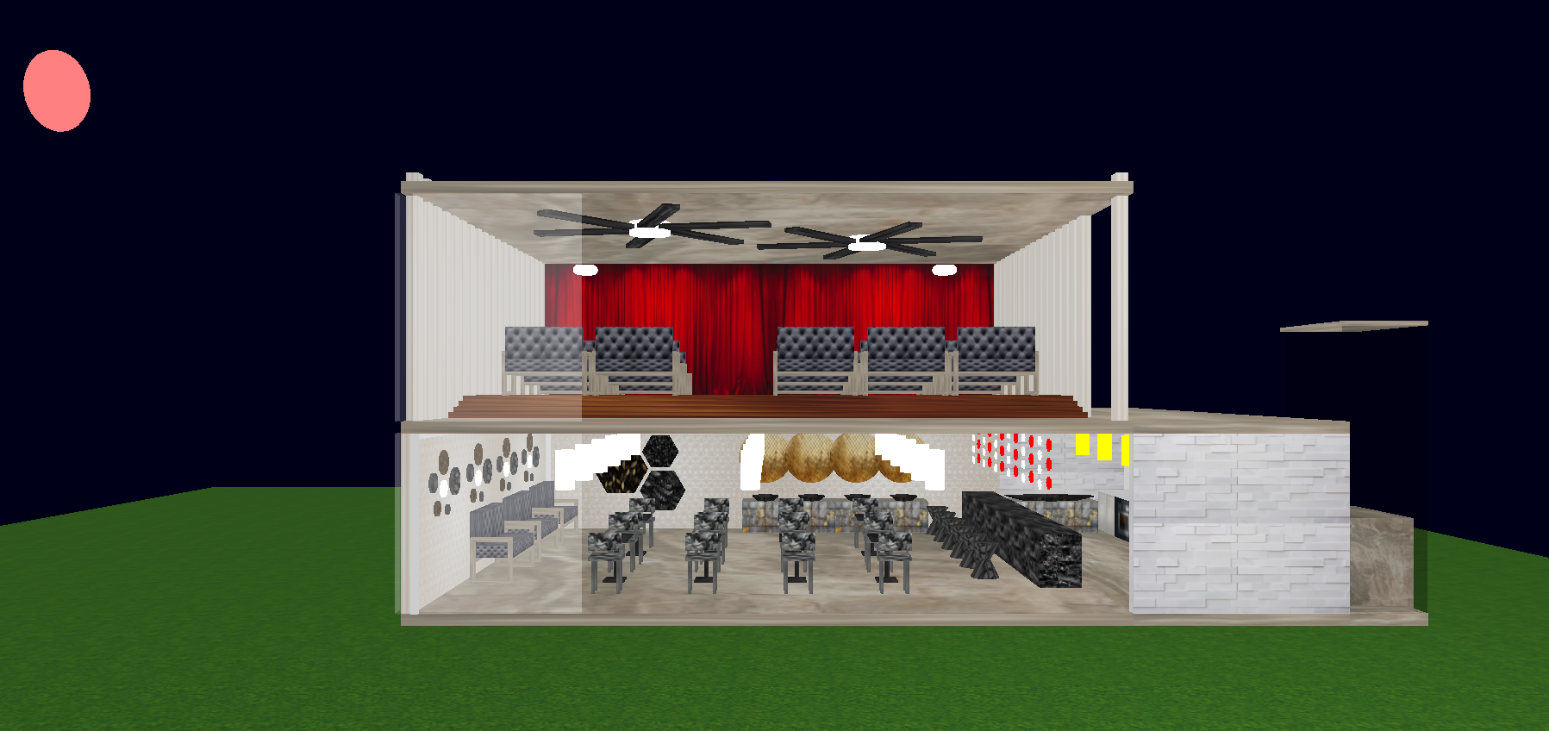
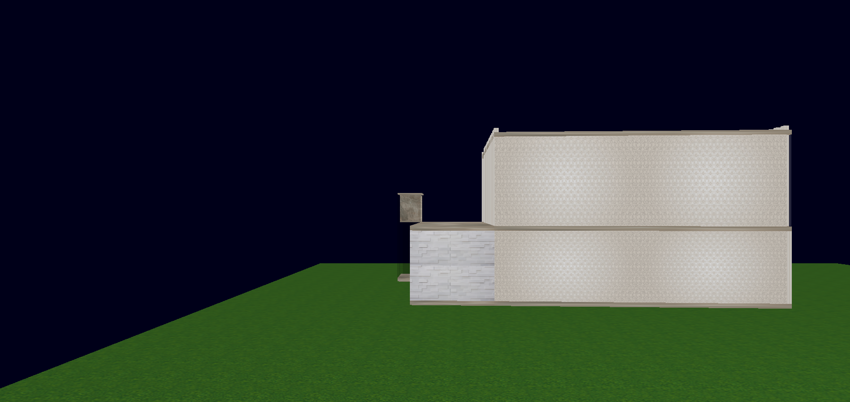
Features (Views)
Front view and back view.
Fig 1.1: Front view
Fig 1.2: Back view

Slide 7
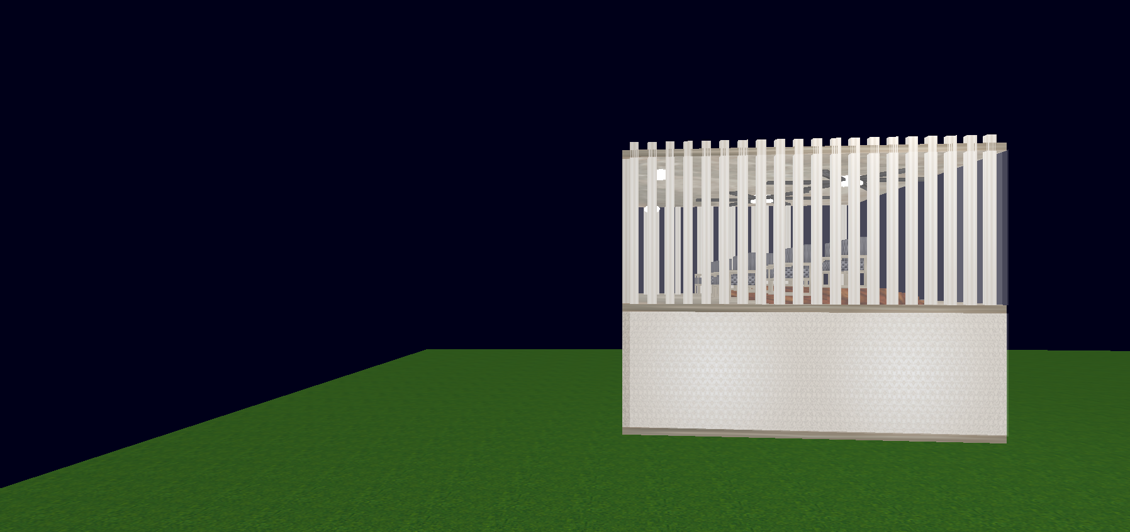
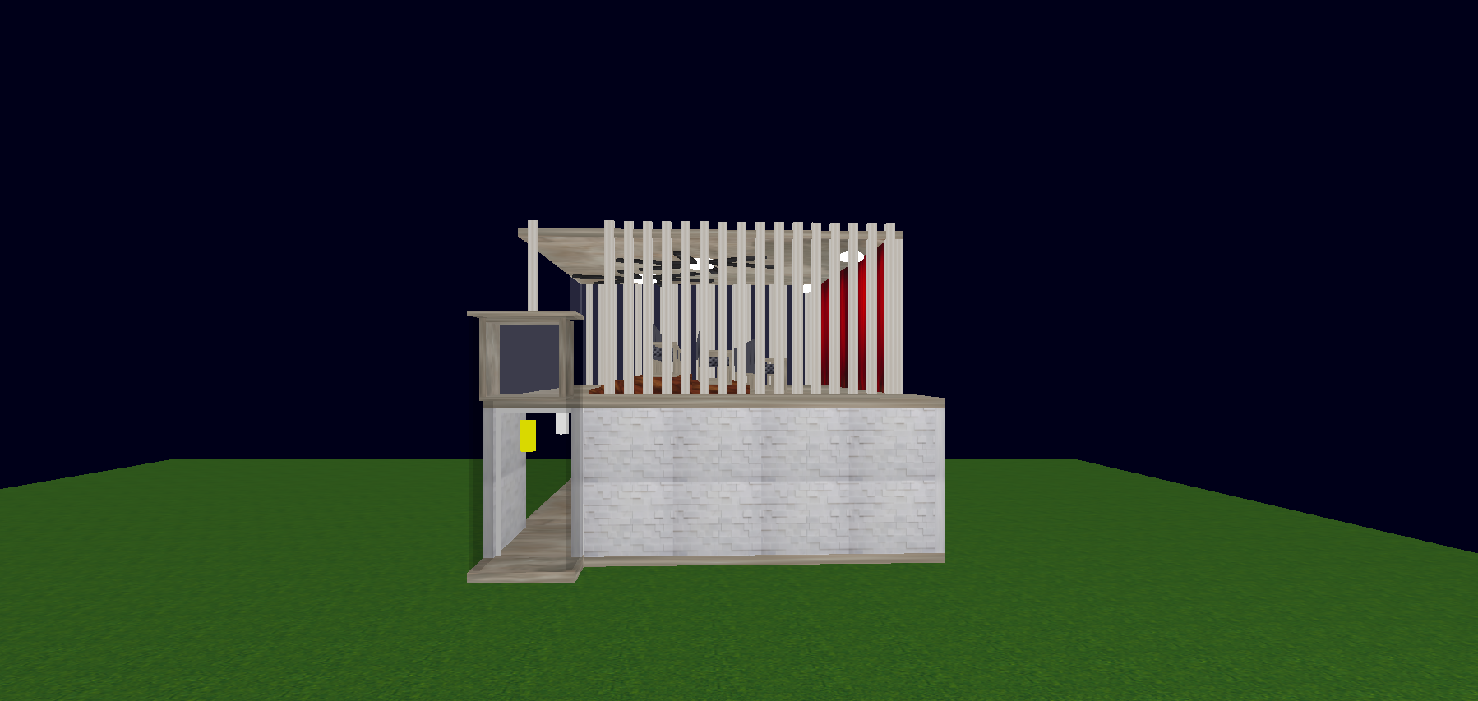
Features (Views) Cont’d
Left view and right view.
Fig 1.3: Left view
Fig 1.4: Right view

Slide 8
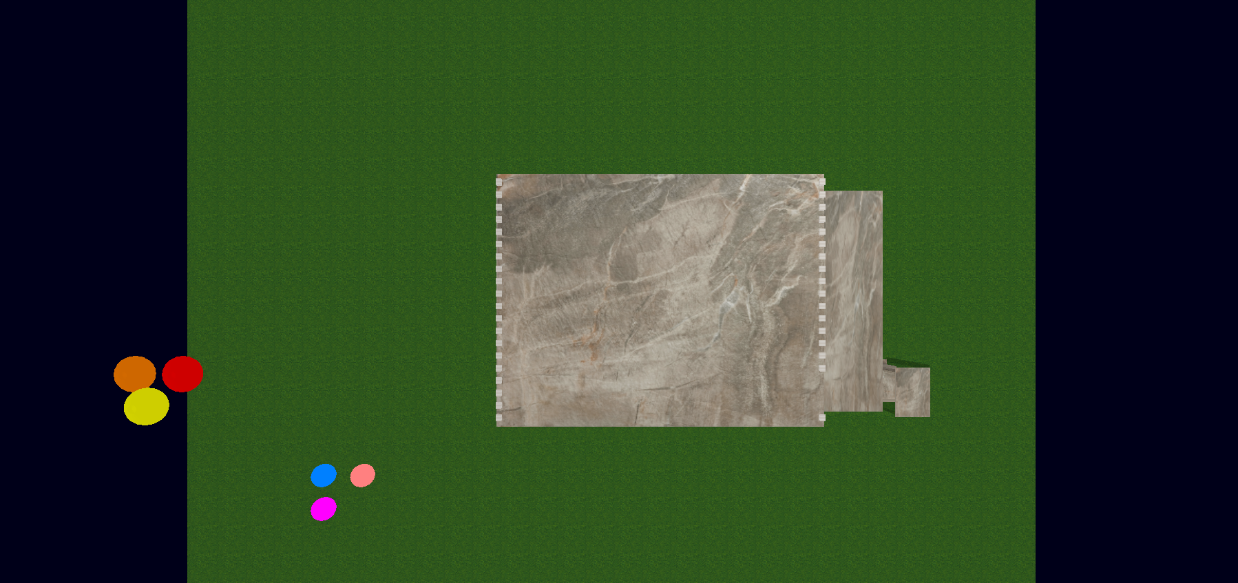

Features (Views) Cont’d
Top view and bottom view.
Fig 1.5: Top view
Fig 1.6: Bottom view

Slide 9
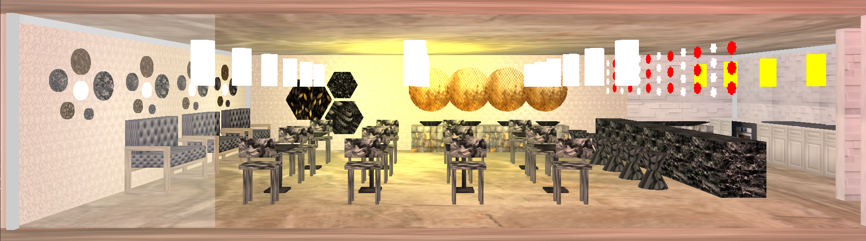
Features (Spots)
Cafeteria and kitchen view.
Fig 2.1: Cafeteria and kitchen

Slide 10
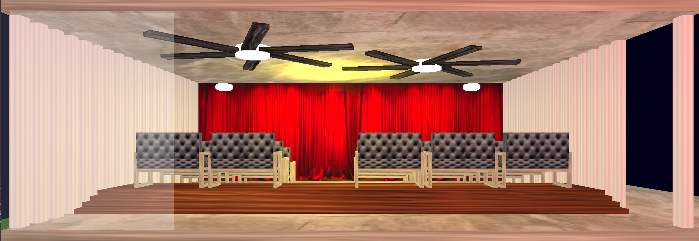
Features (Spots) Cont’d
Theater view.
Fig 2.2: Theater

Slide 11
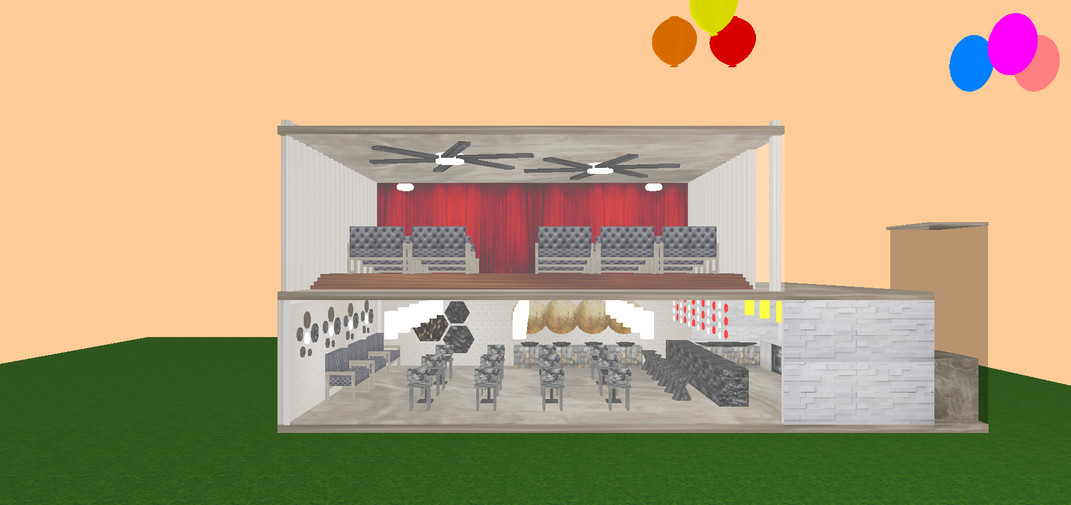
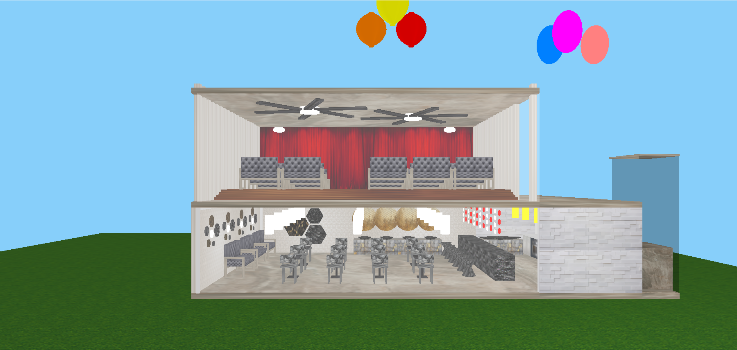
Features (Daylights)
Press B+1 for morning scene, B+2 for noon scene.
Fig 3.1: Morning Scene
Fig 3.2: Noon Scene

Slide 12
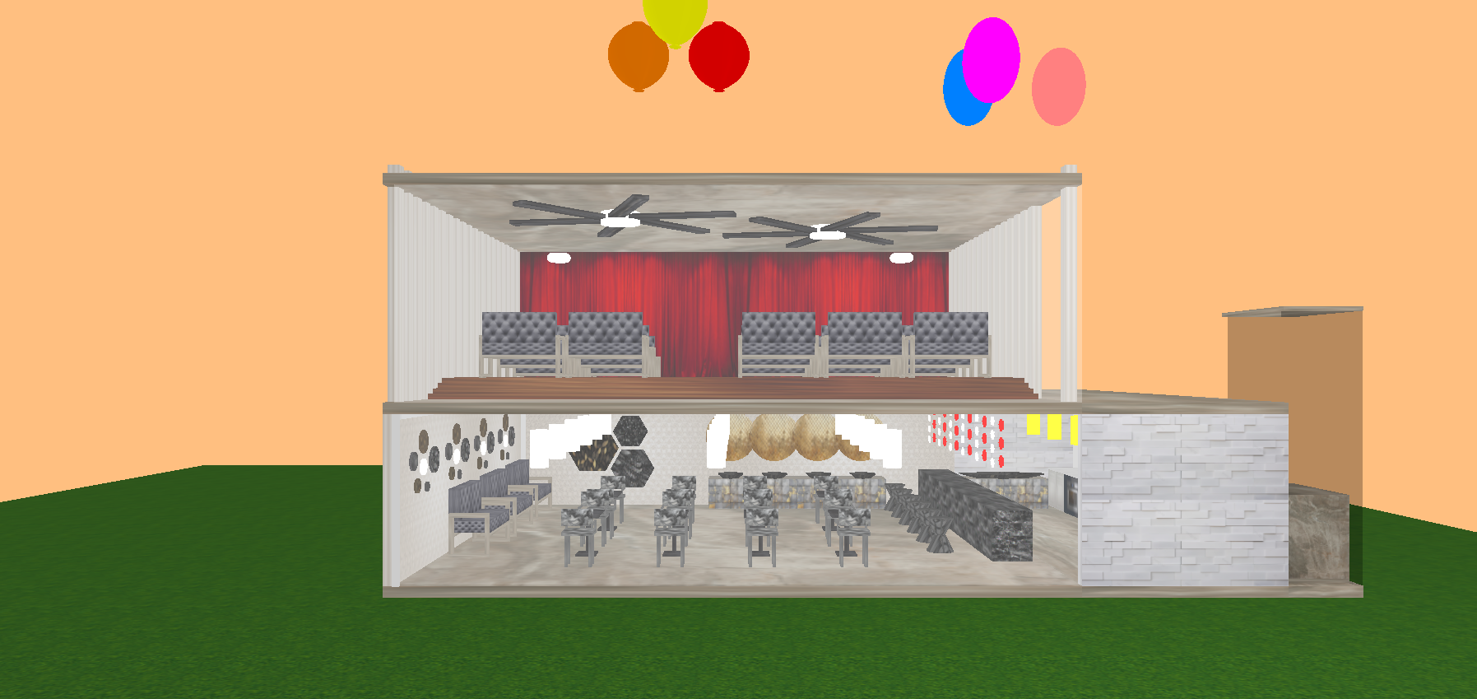
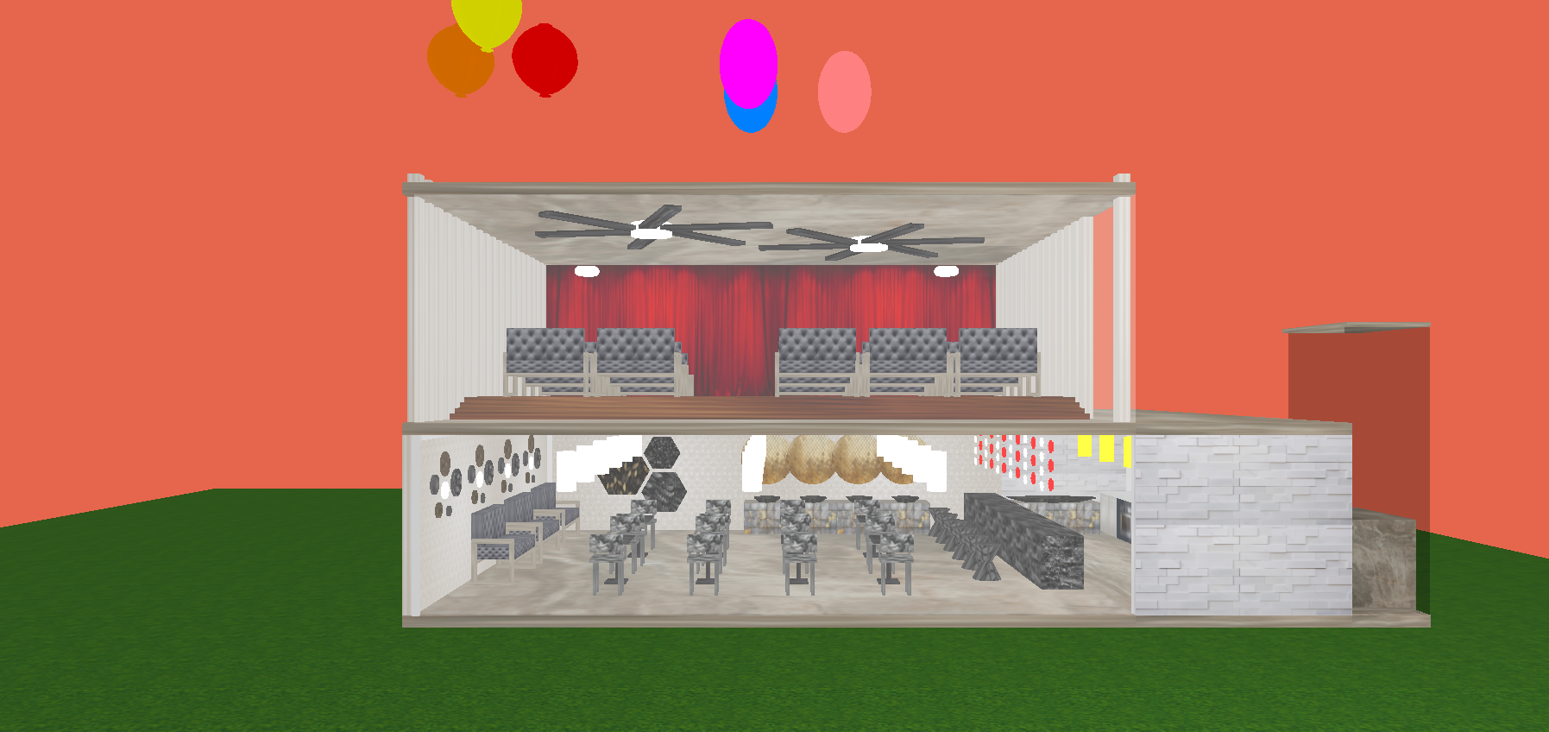
Features (Daylights) Cont’d
Press B+3 for afternoon scene, B+4 for evening scene.
Fig 3.3: Afternoon Scene
Fig 3.4: Evening Scene

Slide 13
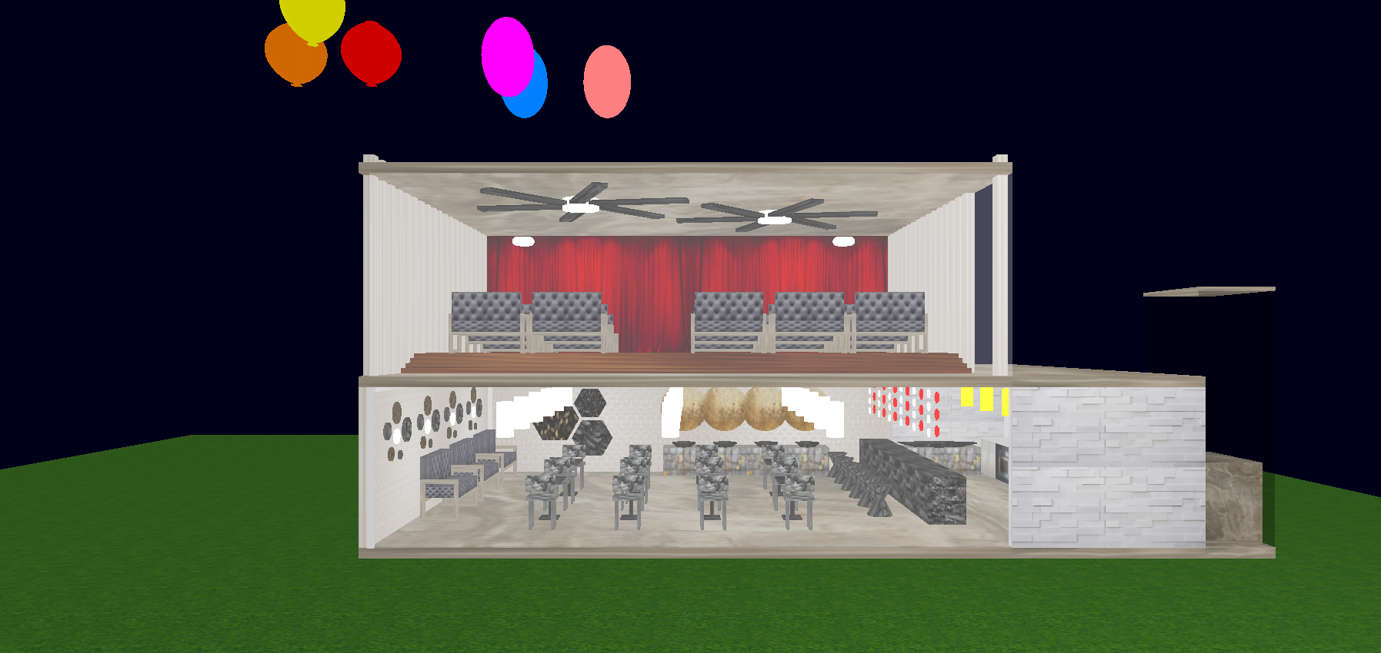
Features (Daylights) Cont’d
Press B+5 for night scene.
Fig 3.5: Night Scene

Slide 14
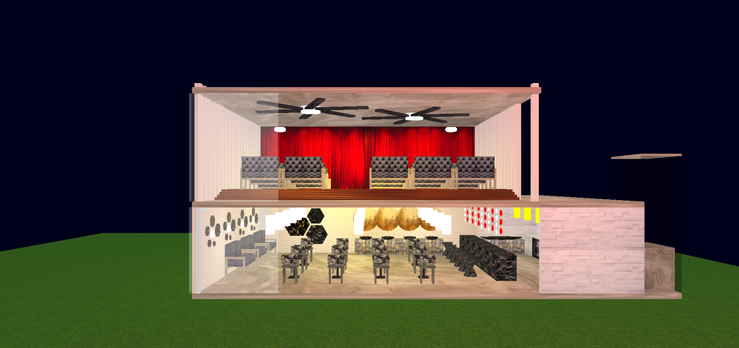
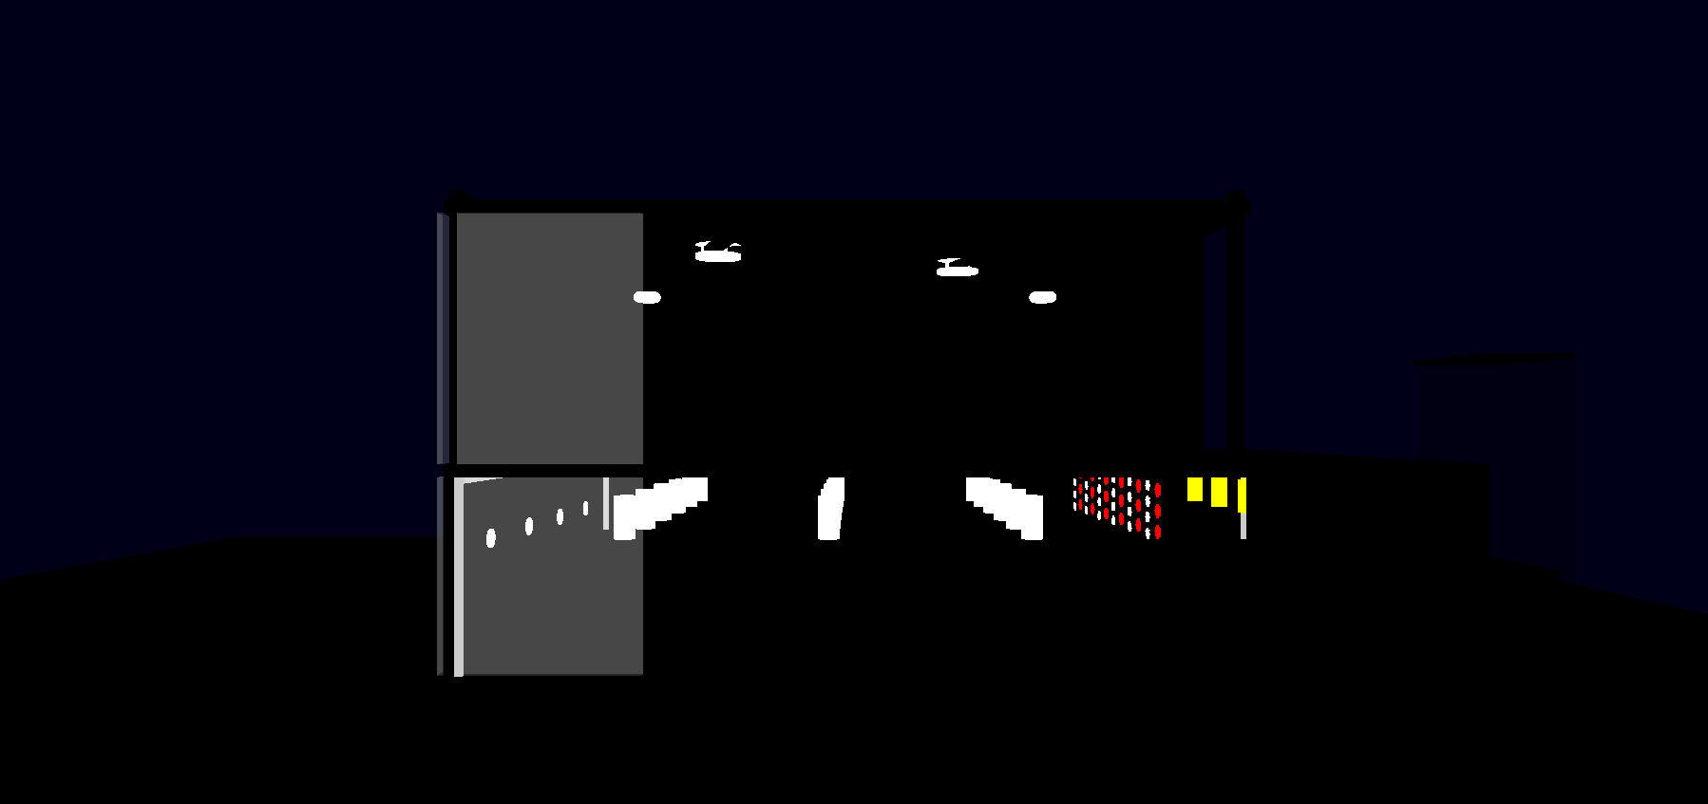
Features (Lighting)
Press L+1 to turn on all lights, B+2 to turn off all lights.
Fig 4.1: All lights on
Fig 4.2: All lights off

Slide 15
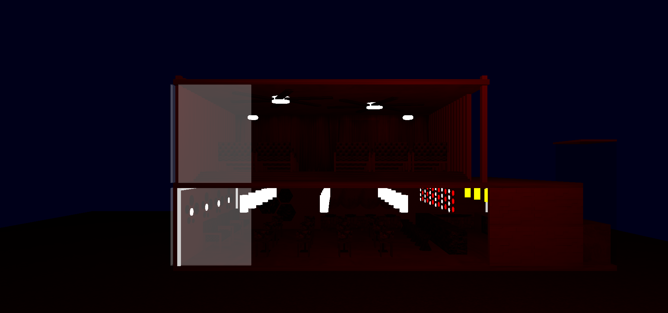
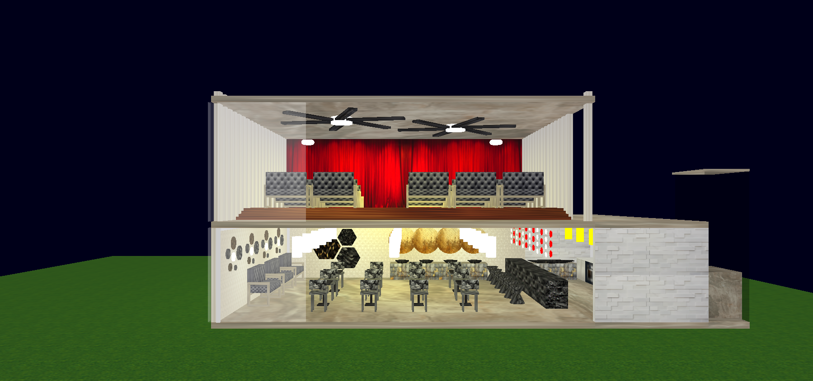
Features (Lighting) Cont’d
Press L+3 to turn on only the point lights (Spotlight and Directional light are off), L+4 to turn off only point lights (Spotlight and Directional light are on).
Fig 4.3: Only point lights on
Fig 4.4: Only point lights off

Slide 16

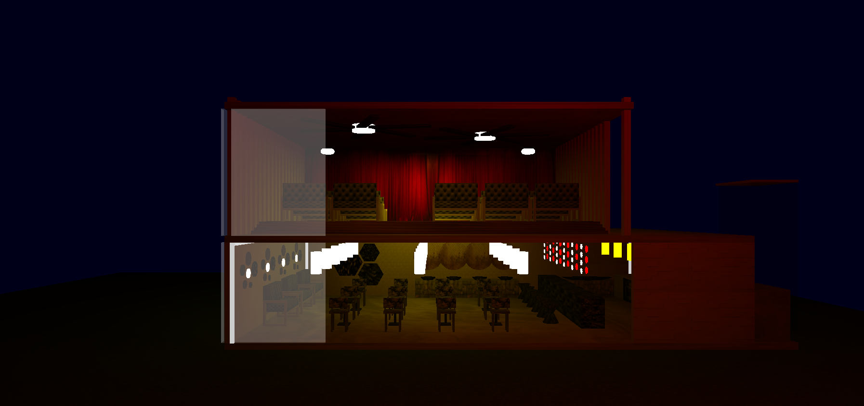
Features (Lighting) Cont’d
Press L+5 to turn on only directional light (Spotlight and point lights are off), L+6 to turn off only directional light (Spotlight and point lights are on).
Fig 4.5: Only directional light on
Fig 4.6: Only directional light off

Slide 17
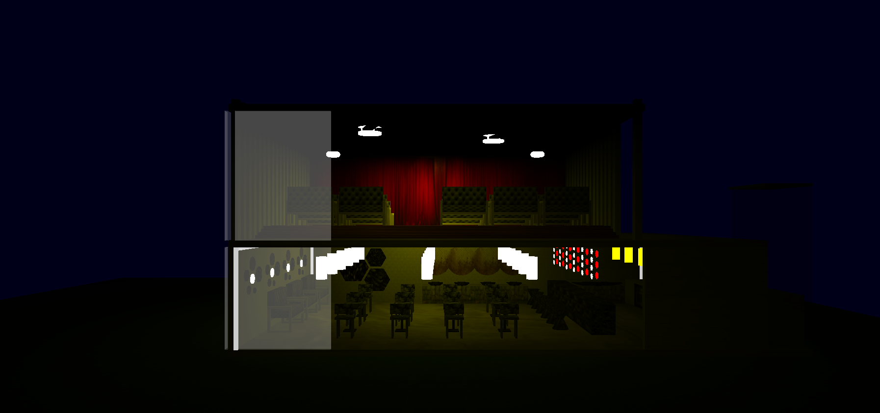
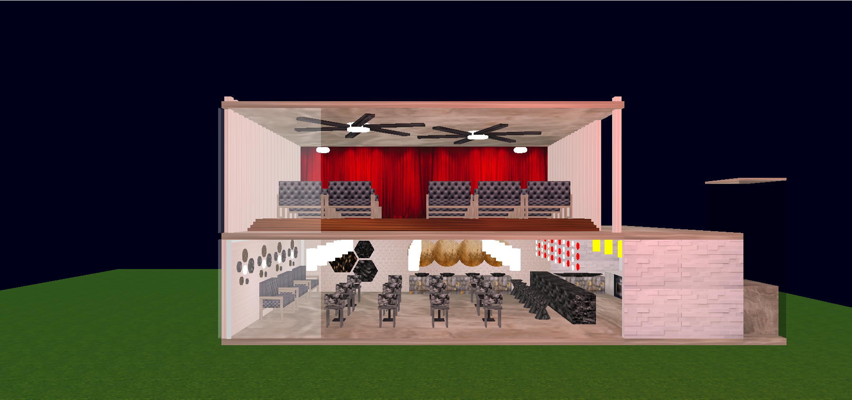
Features (Lighting) Cont’d
Press L+7 to turn on only spotlight (Directional light and point lights are off), L+8 to turn off only spotlight (Directional light and point lights are on)
Fig 4.7: Only spotlight on
Fig 4.8: Only spotlight off

Slide 18
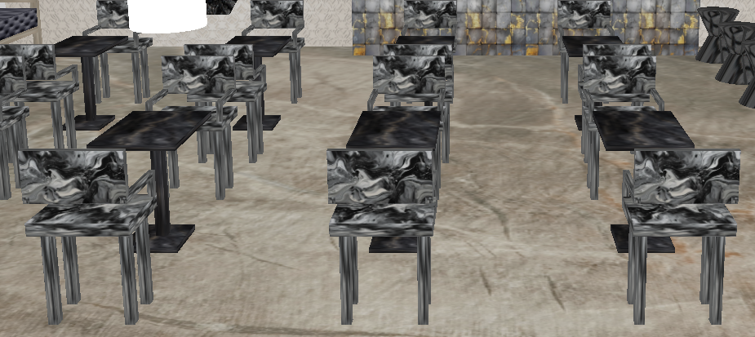
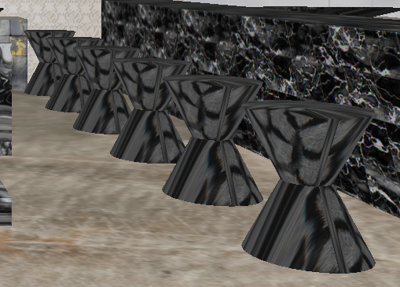
Features (Objects)
Chairs and tables are made of cubes, and tools are made of cubes.
Fig 5.1: Chair-Table
Fig 5.2: Tool

Slide 19
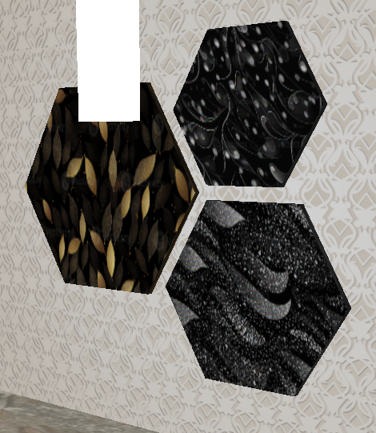
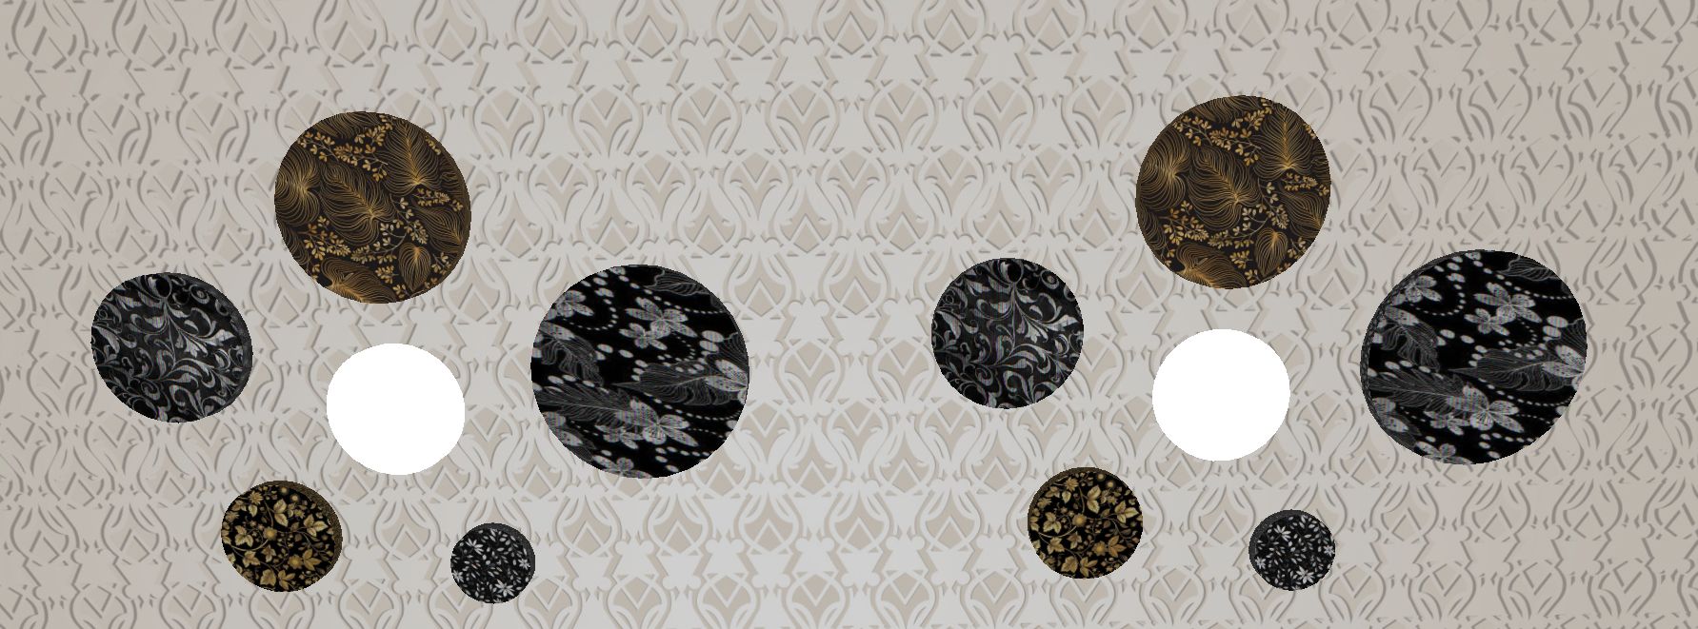
Features (Objects) Cont’d
Interior designs are made of hexagons and cylinders.
Fig 5.3: Interior design

Slide 20
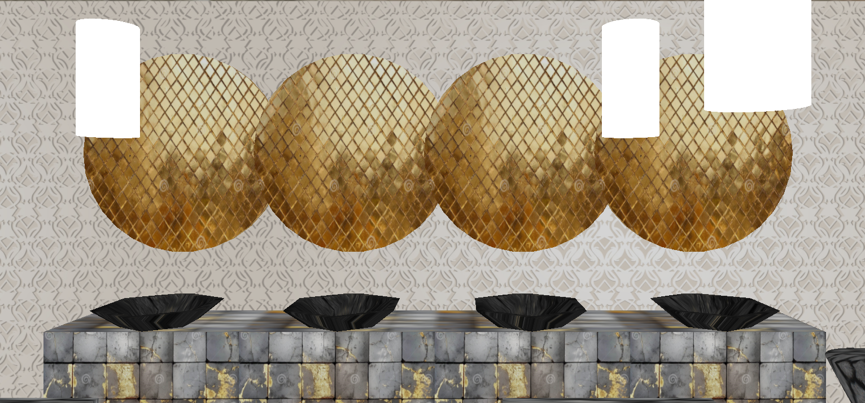
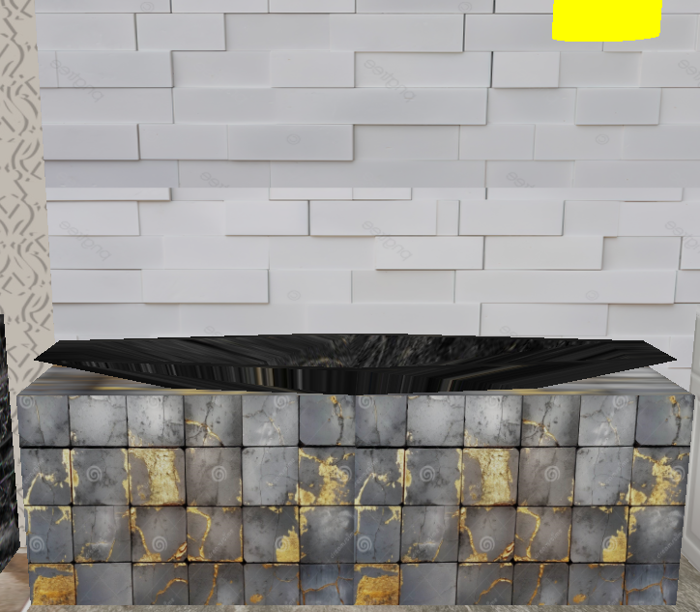
Features (Objects) Cont’d
Mirrors are made of cylinders, sinks are made of hollow hexagons and the kitchen sink is made of hollow pentagon.
Fig 5.4: Mirror and sink
Fig 5.5: Kitchen sink

Slide 21
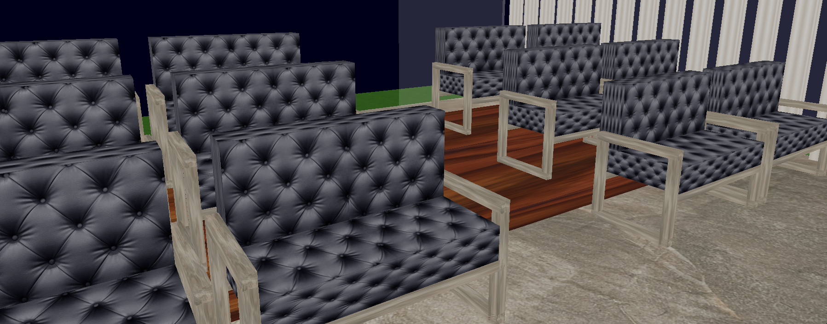
Features (Objects) Cont’d
Sofas and stairs are made of cubes.
Fig 5.6: Sofa and stair

Slide 22
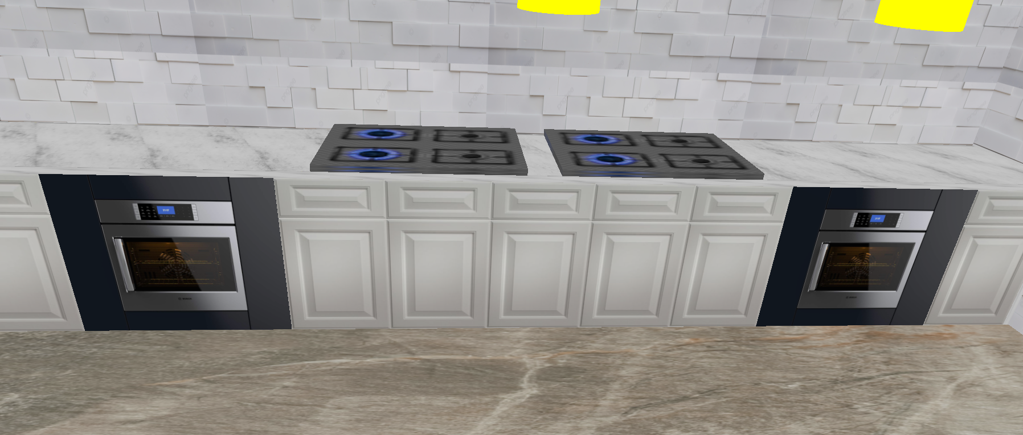
Features (Objects) Cont’d
Cabinets, stoves and microwave ovens are made of cubes with textures.
Fig 5.7: Kitchen

Slide 23
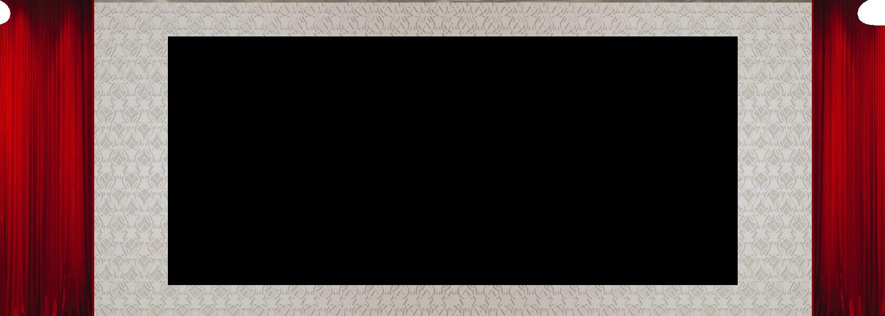
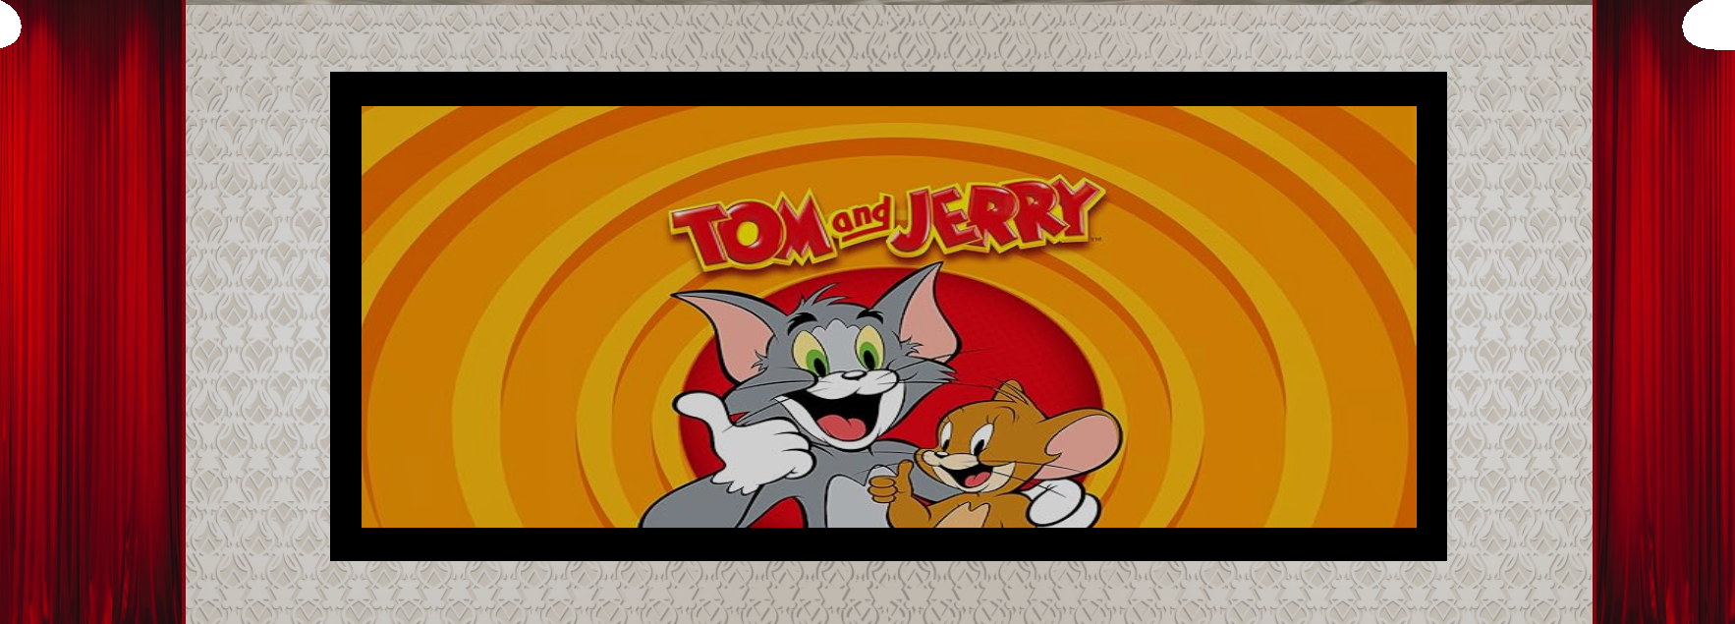
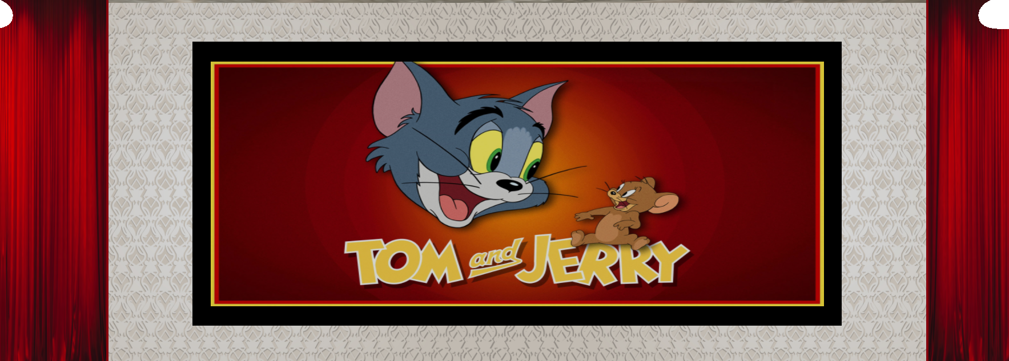
Features (Objects) Cont’d
Television is made of cubes and textures.
Fig 5.8: Television

Slide 24
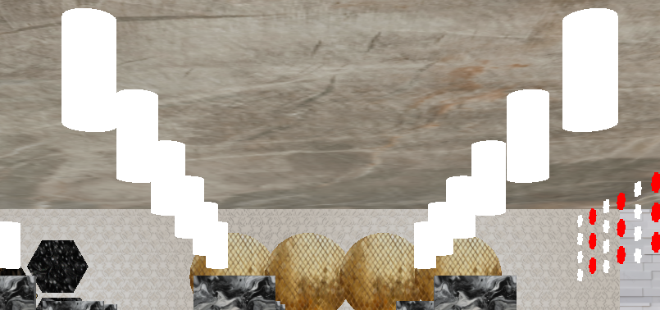
Features (Light Objects)
Cylinder lights.
Fig 6.1: Cylinder light

Slide 25
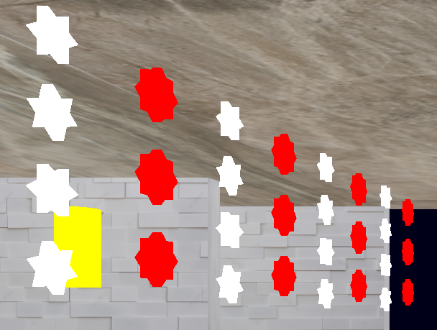

Features (Light Objects) Cont’d
Star lights are made of triangles and cubes, Torus light is made of cubes.
Fig 6.2: Star light
Fig 6.3: Torus light

Slide 26
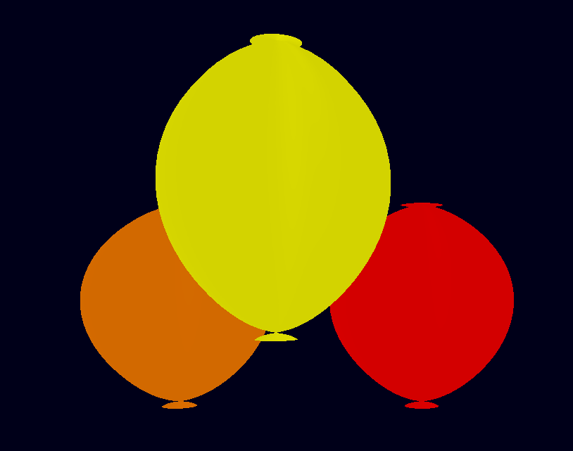
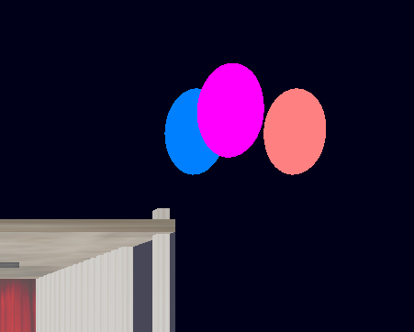
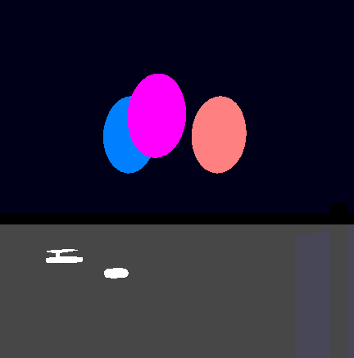
Features (Light Objects) Cont’d
Ballons are made of Bezier curve, Light ballons are made of spheres.
Fig 7.1: Ballon
Fig 7.2: Light ballon

Slide 27
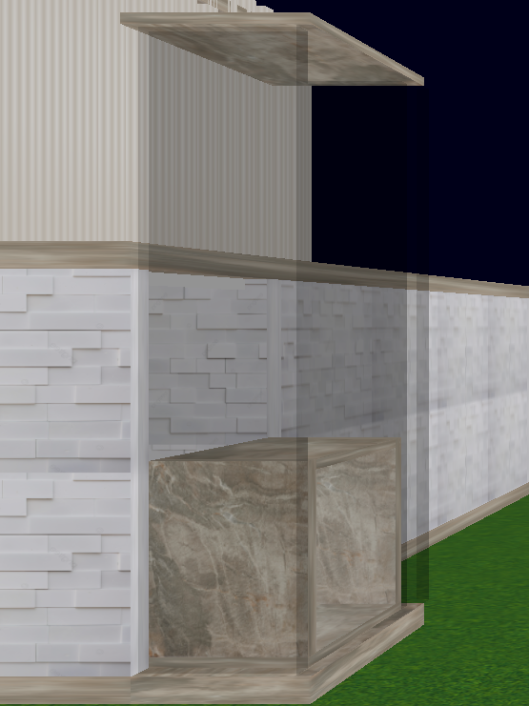
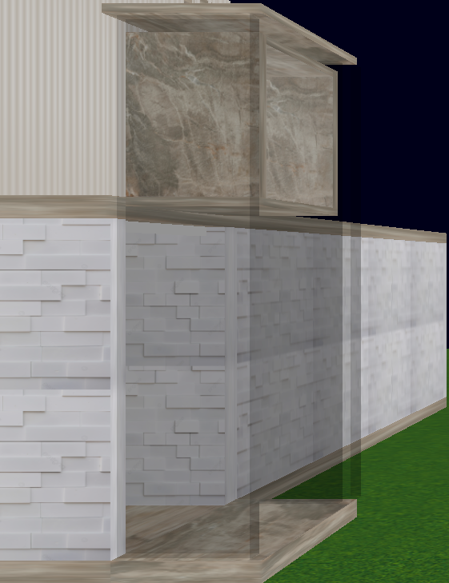
Features (Moving Object: Translation)
Press E+1 to go to the 1st floor, E+2 to go to the ground floor.
Fig 7.3: Lift on ground floor
Fig 7.4: Lift on first floor

Slide 28
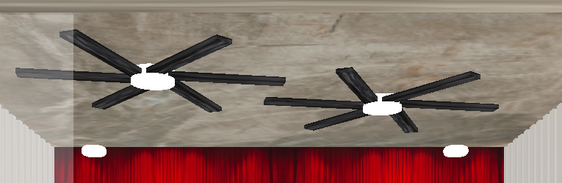
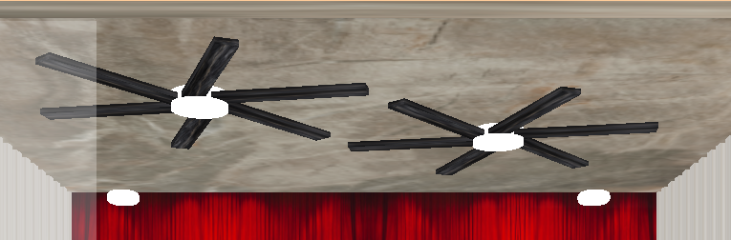
Features (Moving Object: Rotation)
Press F+1 to turn on the fan, F+2 to turn off the fan.
Fig 8.1: Fan off
Fig 8.2: Fan on

Slide 29
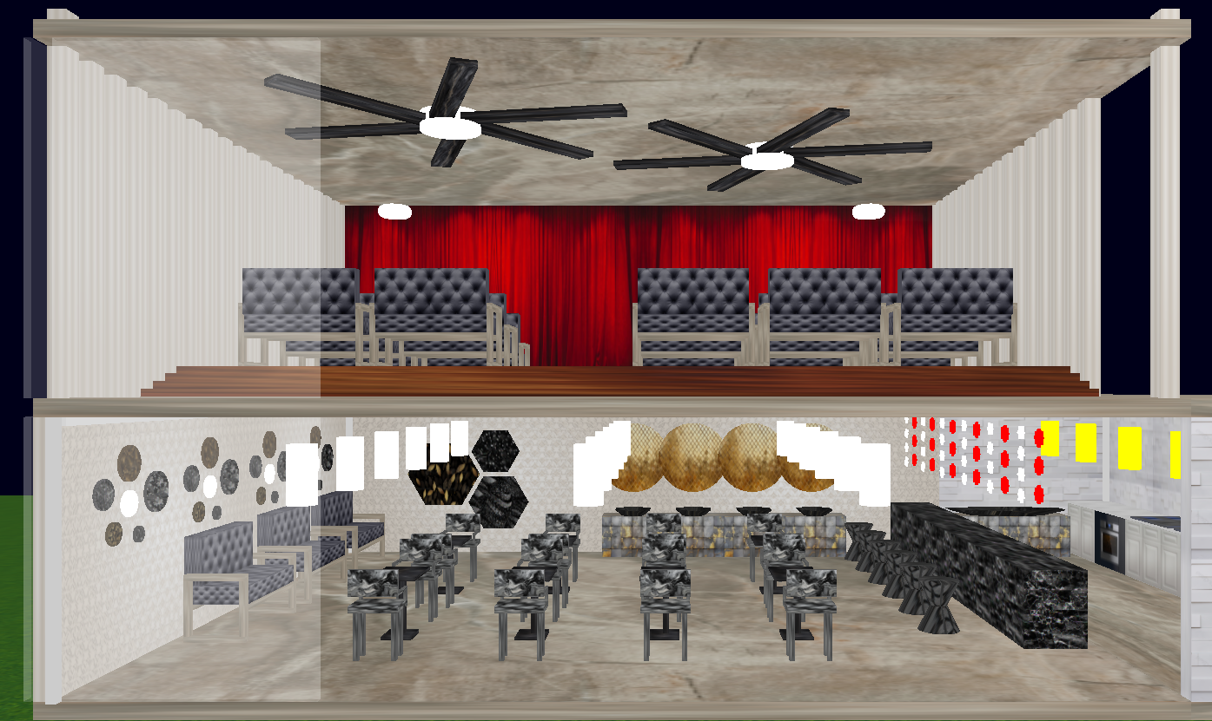
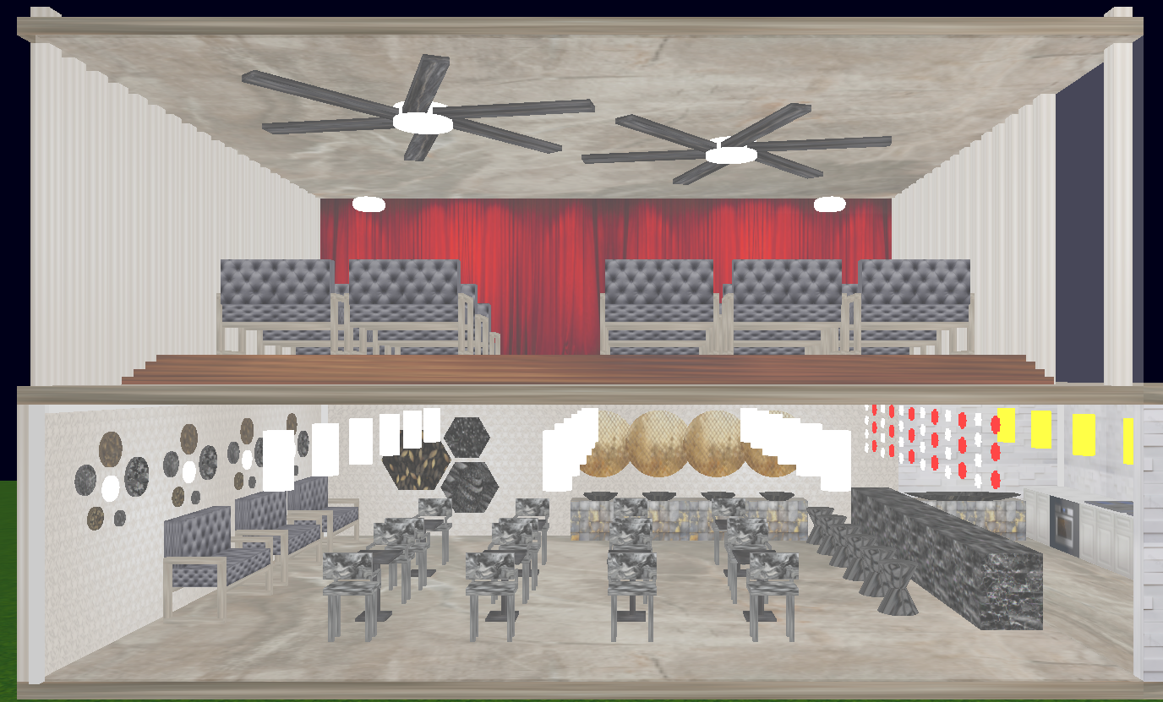
Features (Moving Objects: Scaling)
Press D+1 to open the cafeteria door, D+2 to close the cafeteria door. While opening, the door will bend, and go back. While closing, the door will bend, and go to the right side.
Fig 9.1: Cafeteria door opened
Fig 9.2: Cafeteria door closed

Slide 30
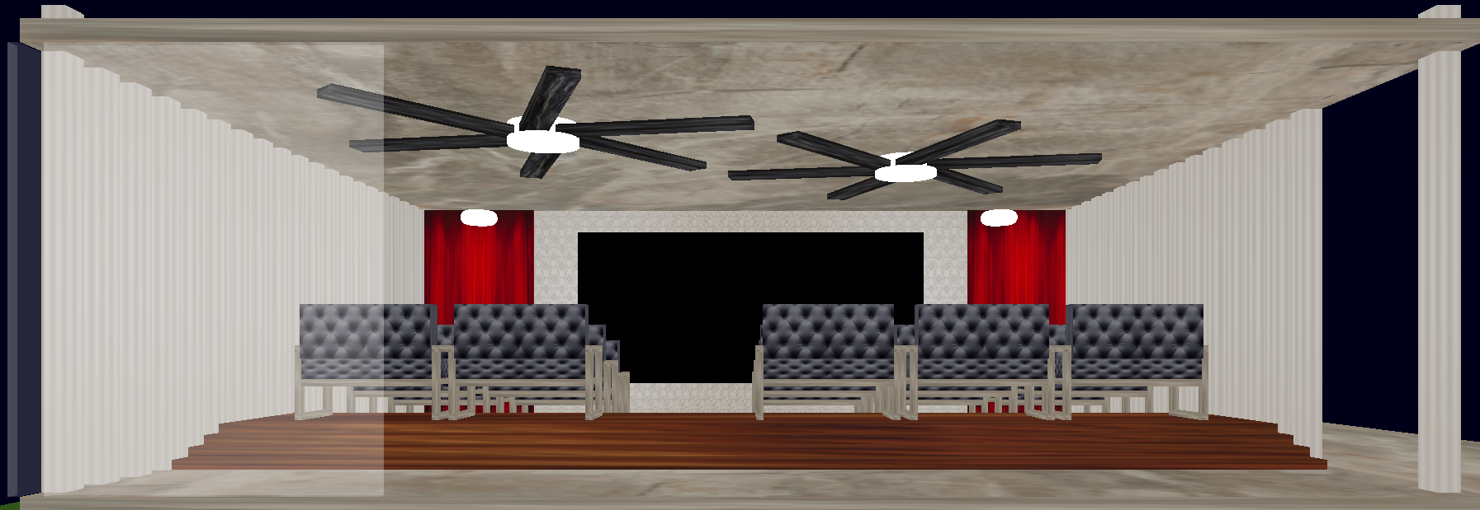
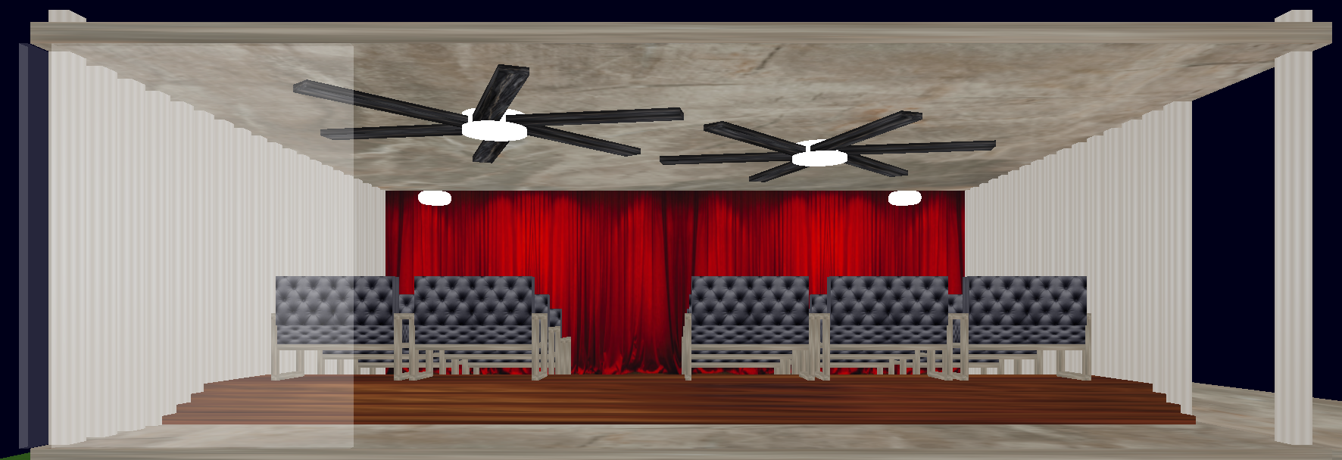
Features (Moving Objects: Scaling) Cont’d
Press C+1 to open the curtain door, C+2 to close the curtain.
Fig 9.3: Curtain opened
Fig 9.4: Curtain closed

Slide 31
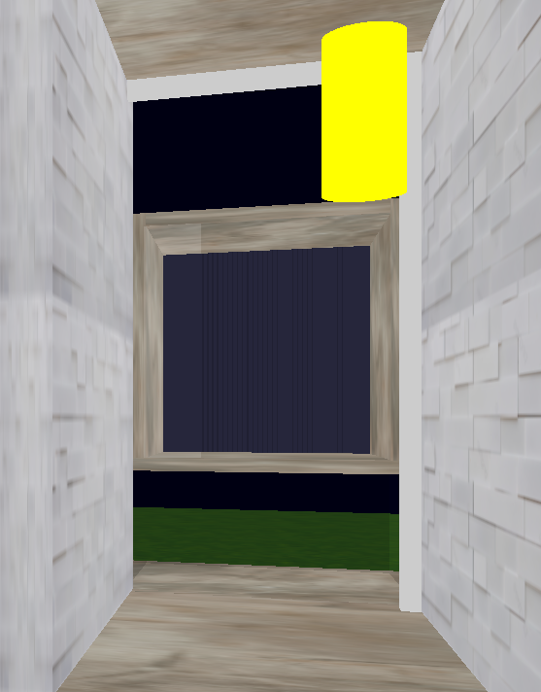
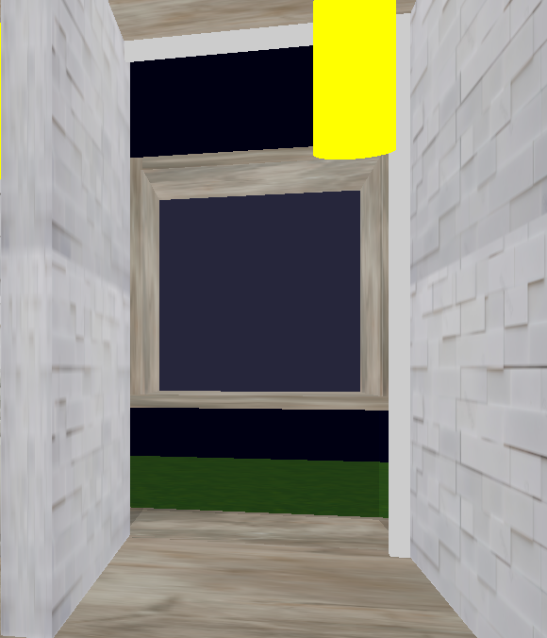
Features (Moving Objects: Scaling) Cont’d
Press O+1 to open the lift door, the door will be closed automatically.
Fig 9.5: Lift door opened
Fig 9.6: Lift door closed

Slide 32
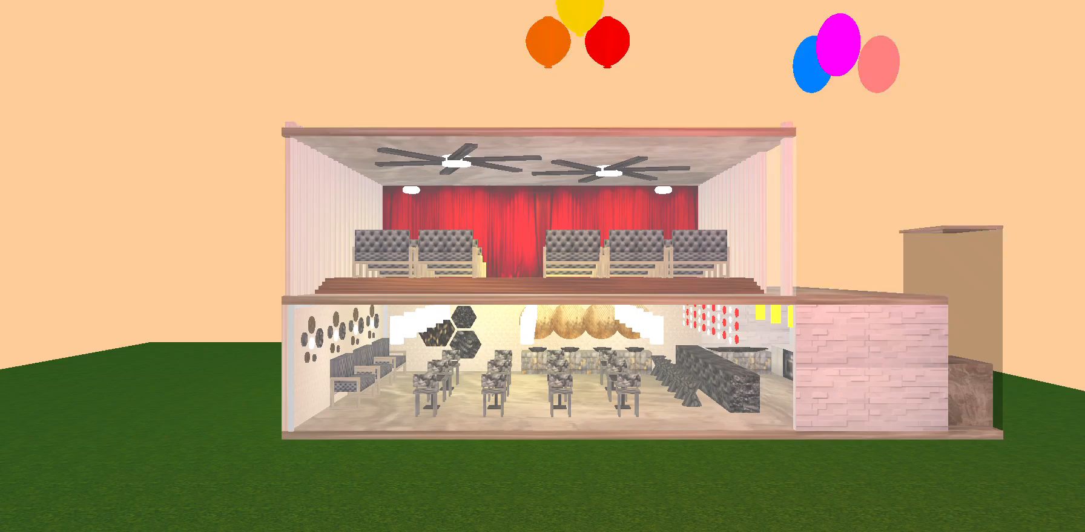
Visual Representation of the Project

Slide 33
Conclusion
The project integrates functional and dynamic design elements.
Advanced OpenGL techniques enhance realism with lighting and textures.
3D objects and motion create an interactive experience.
Realistic day modes and lighting add depth to the environment.

Slide 34
THANK YOU

